Slide 1
CHALLENGE GEOSCIENTIST/DATA SCIENTIST
Giang Tran

Slide 2
TASK
Familiarize with the dataset
Compare the SOM estimates with the corresponding POLARIS estimates
Build and evaluate predicted SOM models
DATA:
stenon_challenge_geoDS.csv
POLARIS data portal http://hydrology.cee.duke.edu/POLARIS/PROPERTIES/v1.0

Slide 3
PART-1: Familiarize with the dataset
Non values/empty/duplicate
Remove non values
Check the instrument measurements
Data inspection
Check estimated values (‘som’)
Remove found outliers
Check Geo-location
Remove the point has wrong location
Mislabeled data
Correct wrong labels

Slide 4
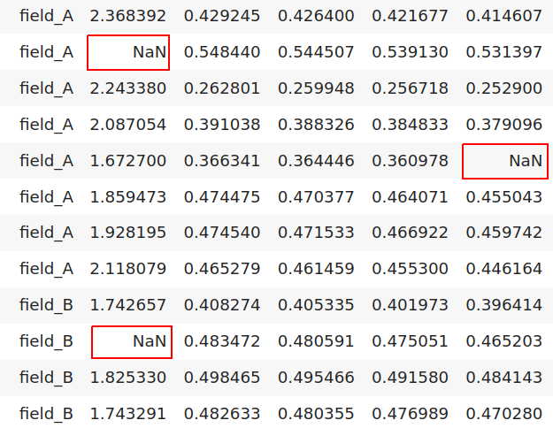
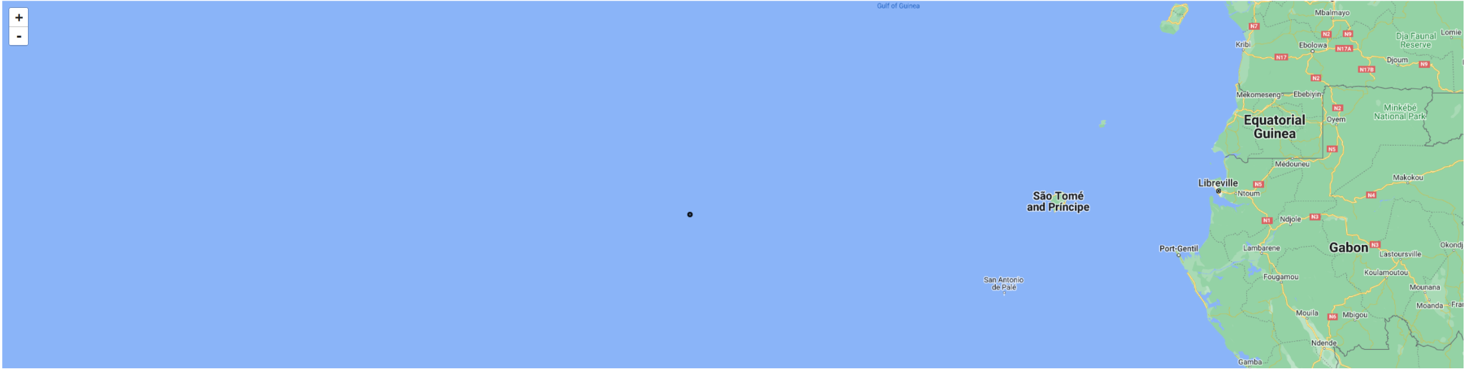
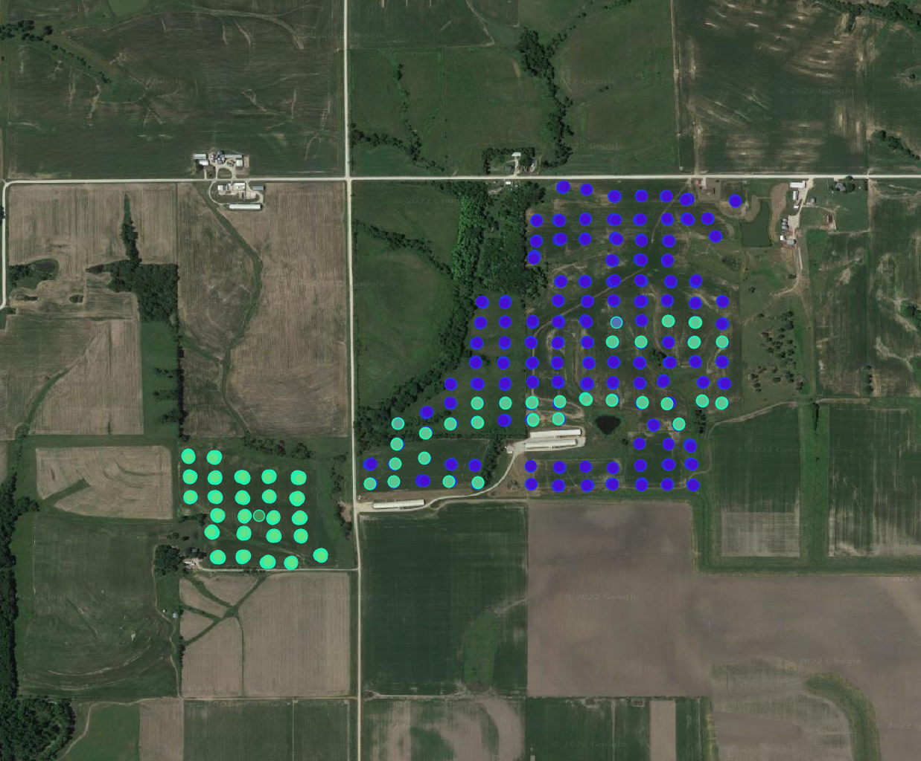
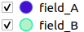
Data issues found:
NaN/Empty element(s) in several records (21 points sample).
Incorrect geo-position (the Lat, Lng coordinates, 01 point sample).
Incorrect data label (“location”, some points of field_A are labelled as field_B).
Incorrect geo-position

Slide 5
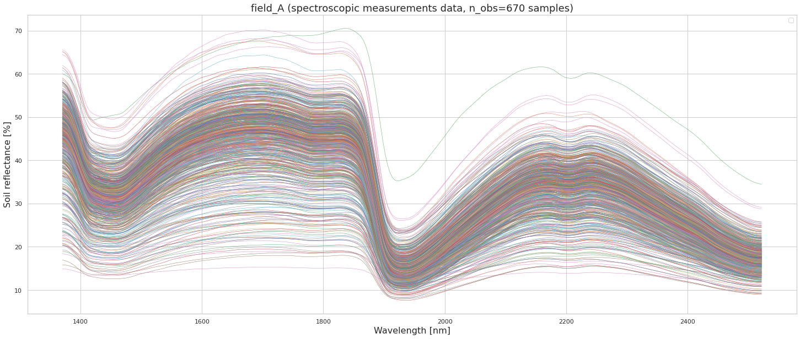
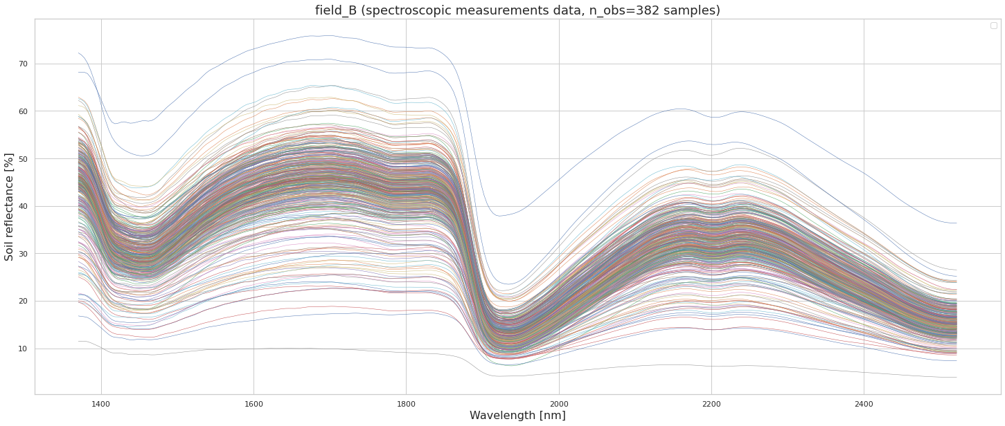
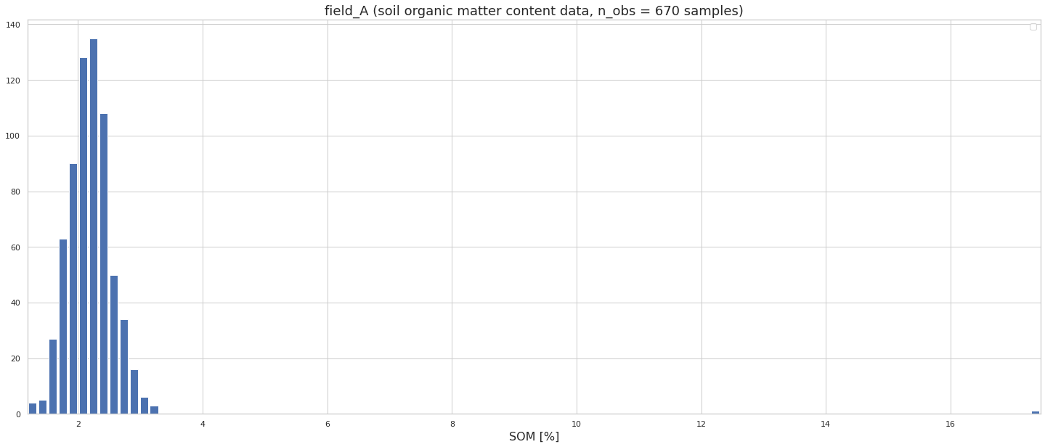
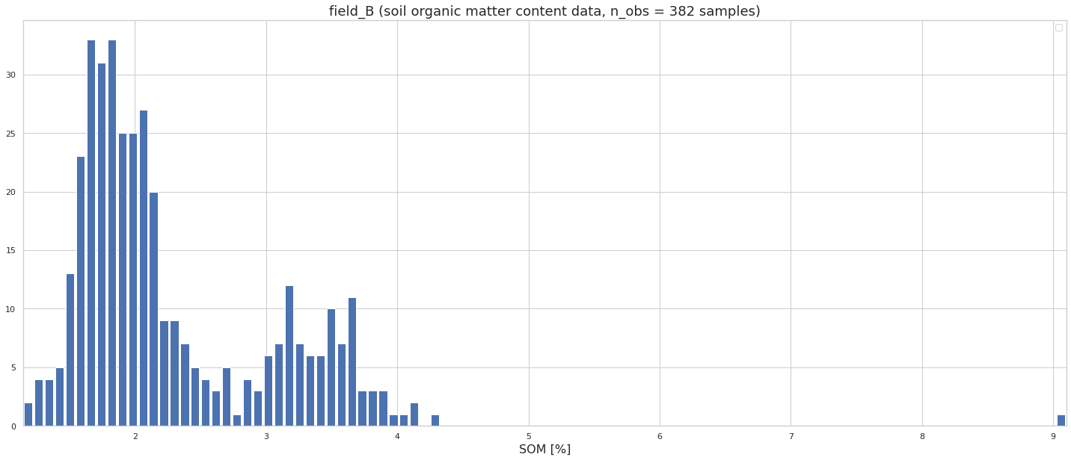
Spectroscopic measurement data & Soil Organic Matter content data
Outliers?
Outliers?
From the spectroscopic measurement, no abnormal errors of measurement are found. But from the histogram of ‘som’ value, there are some abnormal values. To make sure, whether they are outliers we need a further step.

Slide 6
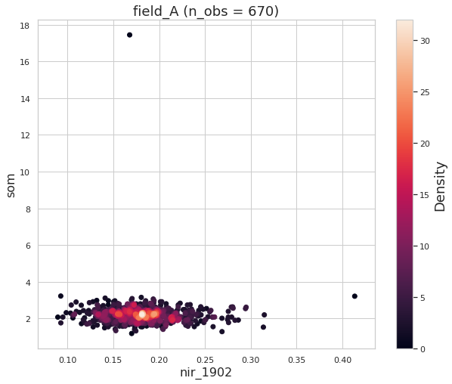
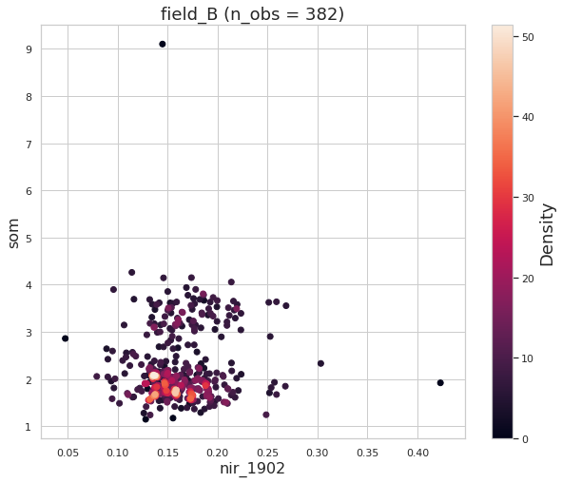
Observed outliers from scatter plot
Outliers of estimated ‘som’ value are detected by scatter plot of ‘som’ values with one spectral value(i.e. nir_1902).

Slide 7
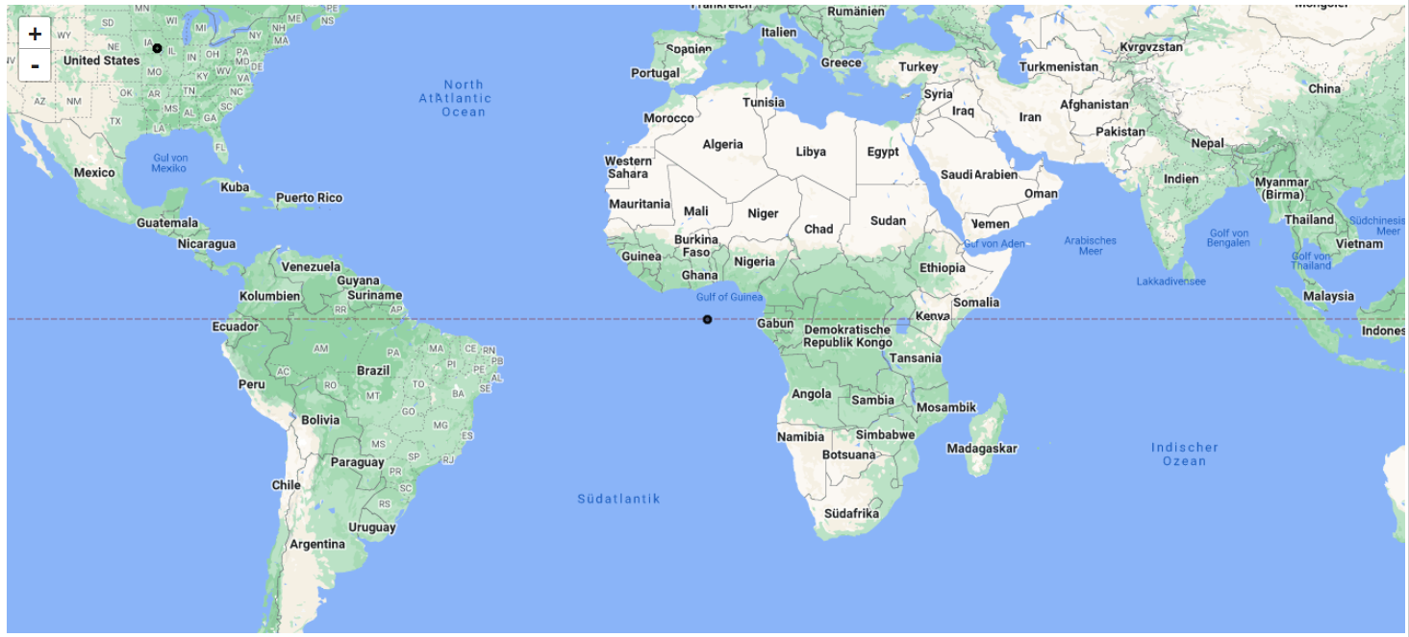
Wrong geo-position correction
To check the geo-position of surveyed points, the following steps need to follow:
Converted csv data format into GEOJSON vector format (the geometry info obtained from ‘lat_lng” attribute).
Open the created GEOJSON in any GIS software/or using geemap and earthengine-api to manipulate the data. The figure below shows there is a wrong geo-position point.
Manipulate the created GEOJSON if needed! The point (below) then was removed from the data due to wrong geo-position.

Slide 8
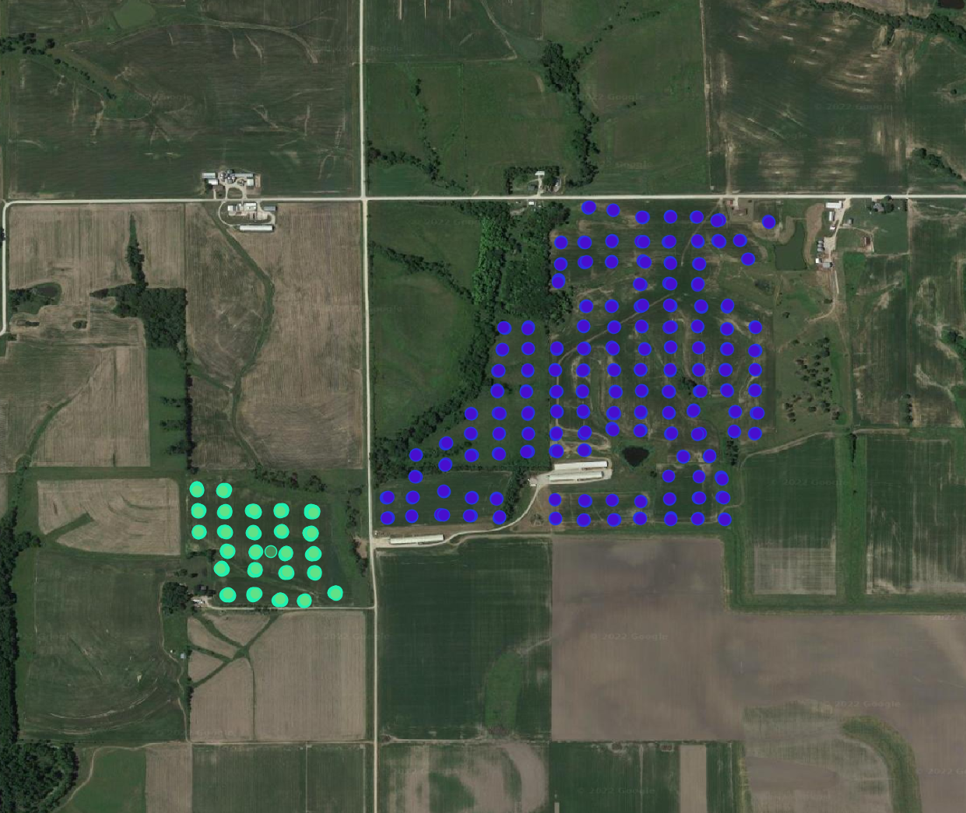
Data label correction
Mislabelling can occur, as consequence it might introduce wrong analyst predictions in further steps. Therefore, the data label is also need to be checked. In order to do it, the points “location” label need to be showed on the map. The mislabelling points label have found (see below figure) and made correction for the points.
Before
After

Slide 9
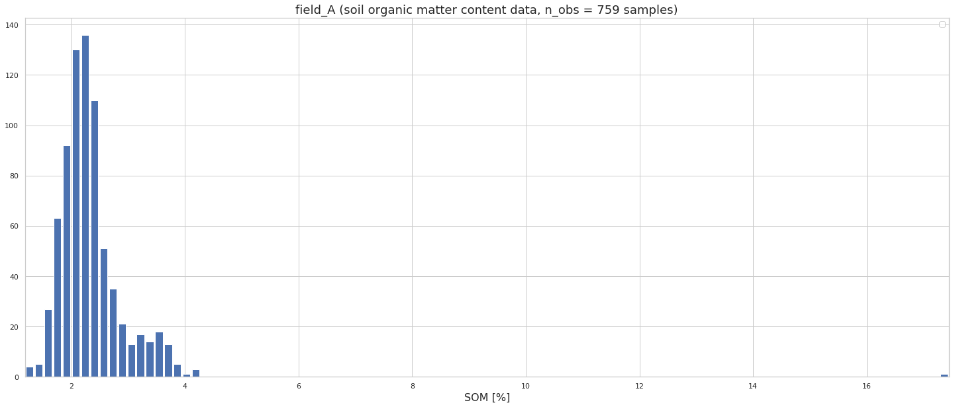
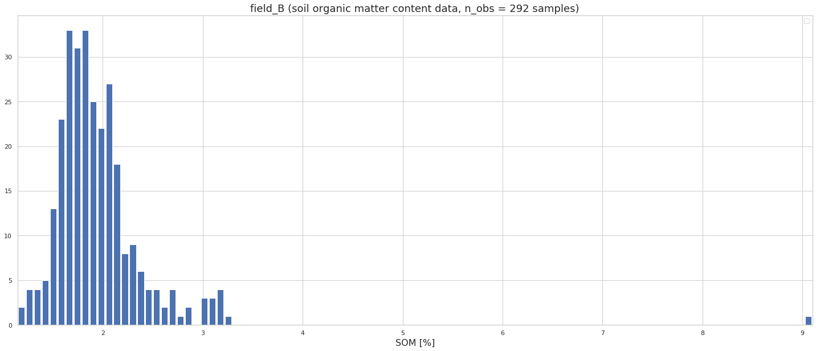
Data label correction
Using histogram to see how the distribution of ‘som’ values (with outliers) in two field change before and after label correction is applied. The results show that, after label correction the distribution shape of ‘som’ values in both fields are kinds of almost normal distributed.
Before
field_A
field_B
After
field_A
field_B

Slide 10
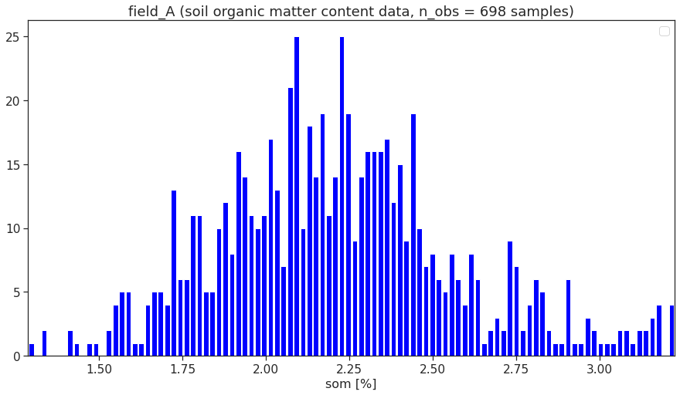
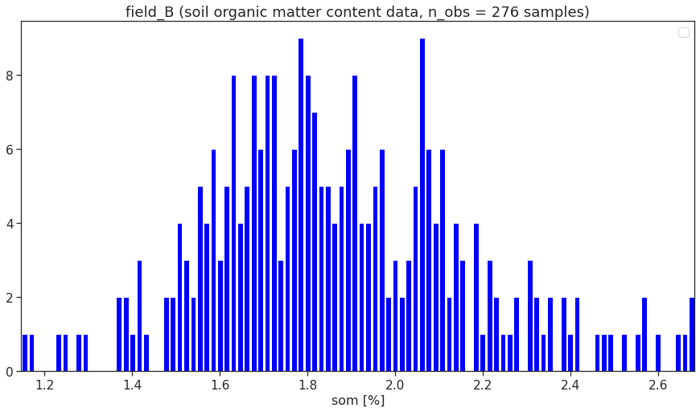
Outliers removal
Before
After
field_A
field_A
field_B
field_B

Slide 11
PART-2: Compare with the POLARIS dataset
om layer
mean,mode,p5 ,p50,p95
15-30cm
5-15cm
0-5cm
Download by (x,y)
Data extraction
om_polaris (create 0-30cm)
Points (x,y)
compare
Results
Polaris data portal
data.csv
Estimated om
Scaling (log10)
om_stenon

Slide 12
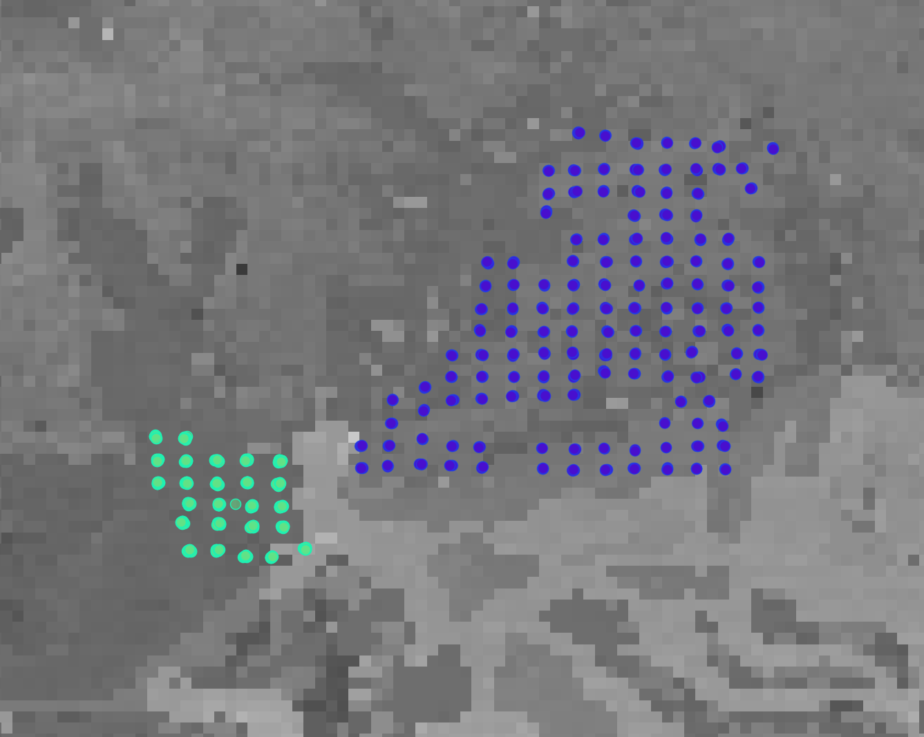
POLARIS soil database
om_0_5cm layer

Slide 13
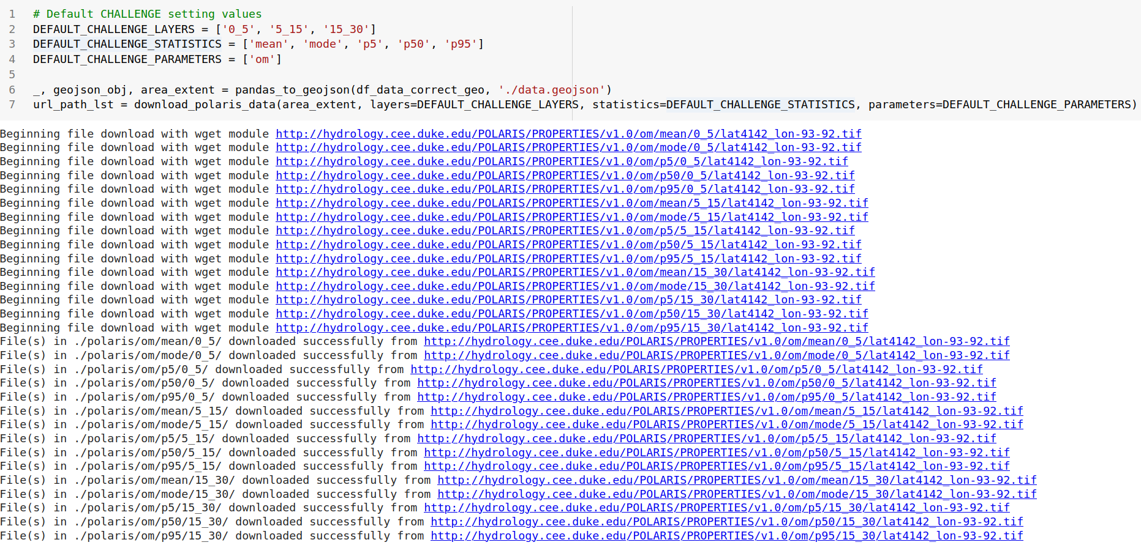
Identify and Download POLARIS om tile layers

Slide 14

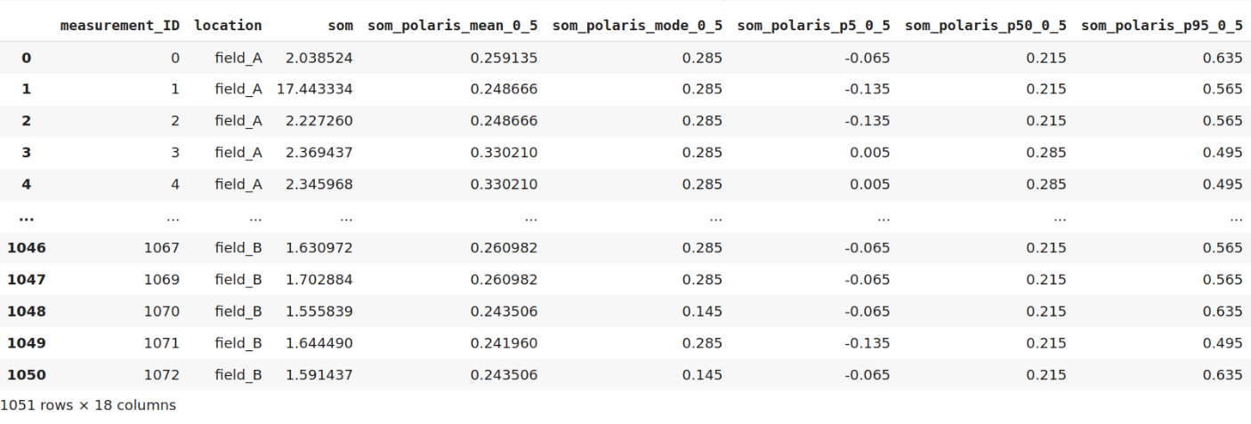
Extract data from POLARIS om tile layers
om_mean_0_5cm
om_mean_5_15cm
om_mean_15_30cm
om_mode_0_5cm
om_mode_5_15cm
om_mode_15_30cm
om_p5_0_5cm
om_p5_5_15cm
om_p5_15_30cm
om_p50_0_5cm
The corresponding ‘om’ values from POLARIS soil database of each soil layer are extracted and saved into table. Due to the unit of ‘om’ from Stenon is [%] while the unit of om from PALARIS is Log10 of [%], therefore, Stenon’s ‘om’ values from .csv file need to be scaled by Log10 before starting the comparison. The results are compared then:
Corresponding som-stenon with POLARIS som each soil layers (0-5, 5-15. 15-30)
Corresponding som-stenon with POLARIS combination (0-30cm)
om_p50_5_15cm
om_p50_15_30cm
om_p95_0_5cm
om_p95_5_15cm
om_p95_15_30cm

Slide 15
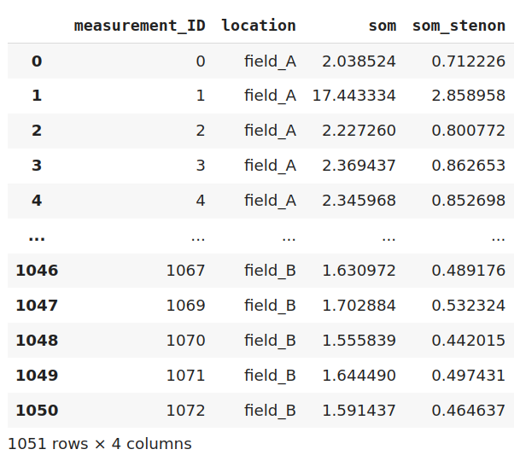
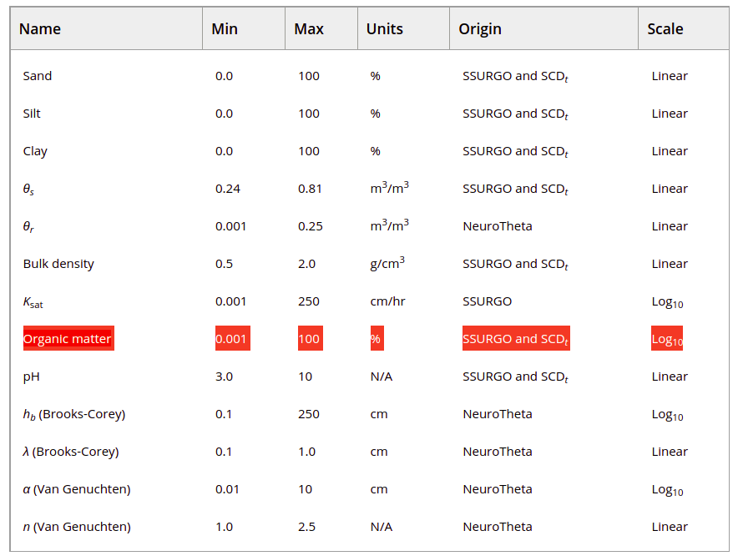
Rescale Stenon om data
Log10(om)
Table 1. Soil Properties That Are Mapped Over the Contiguous United States at a 30-m Spatial Resolution
Need to rescale (Log10) Stenon OM data!

Slide 16
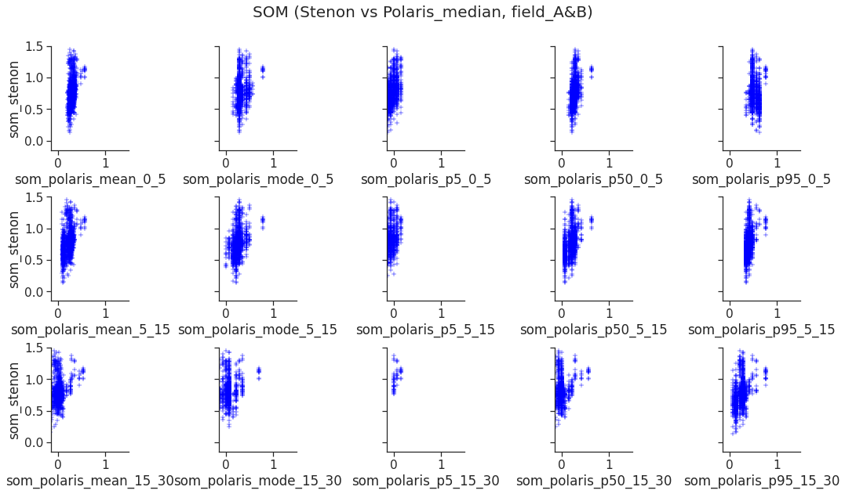
om data comparison:
STENON (0_30cm layer) vs POLARIS (0_5cm, 5_15cm, 15_30cm layer)

Slide 17
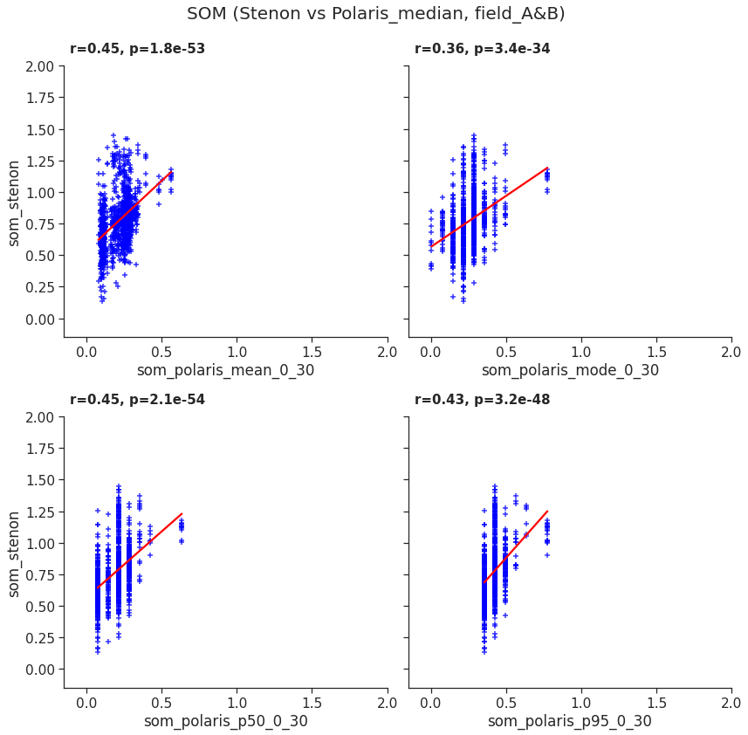
om data comparison:
(Stenon vs Polaris, 0_30cm layer)

Slide 18
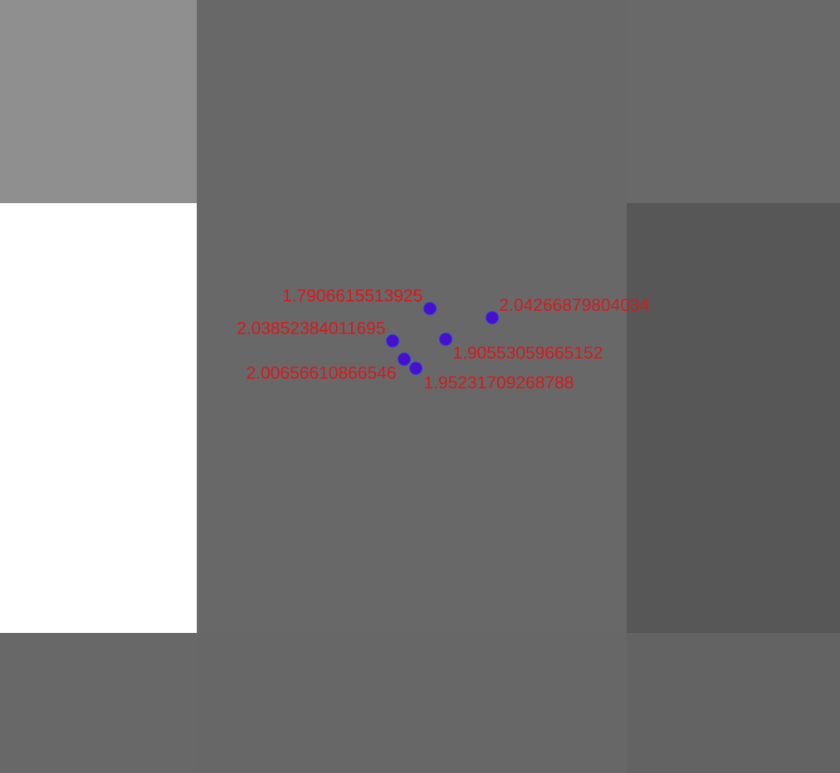
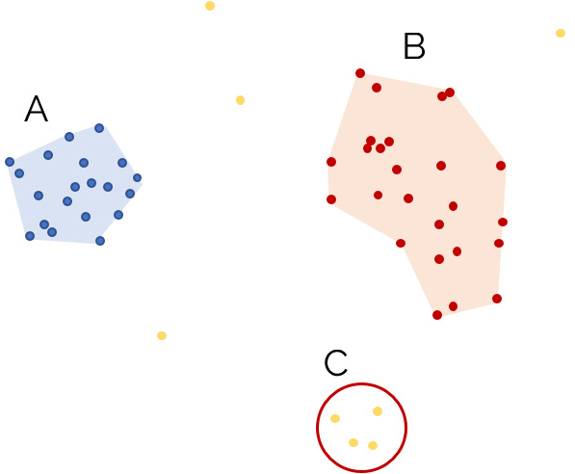
Spatial discrepancy issue!
Based on the geo-position of the surveyed sample points (right plot), the DBSCAN clustering ALGT was used to group the surveyed points sample (via two parameters: the distance and the number of points belong to group) into 157 classes.
30 m
< 10 m
30 m

Slide 19
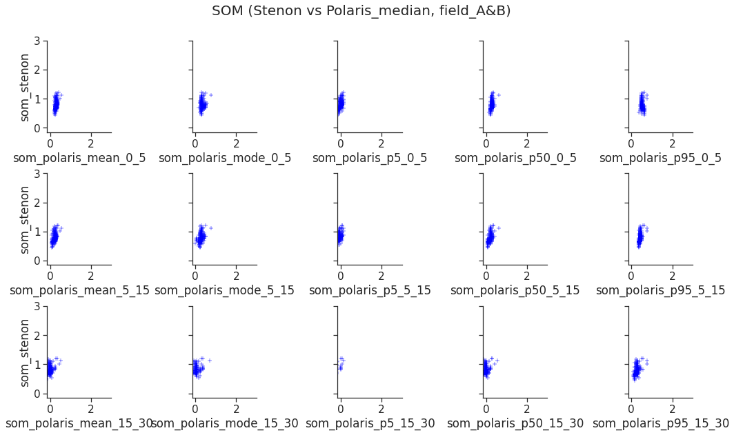
om data comparison (all layers, Stenon’s point_groups vs Polaris)

Slide 20
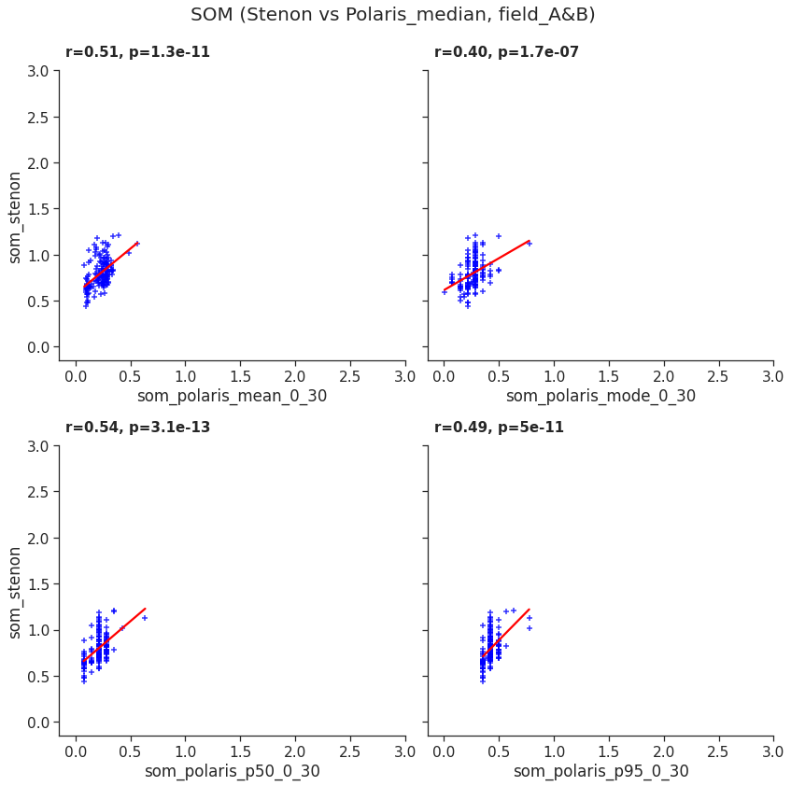
Comparison (vs Grouped)

Slide 21
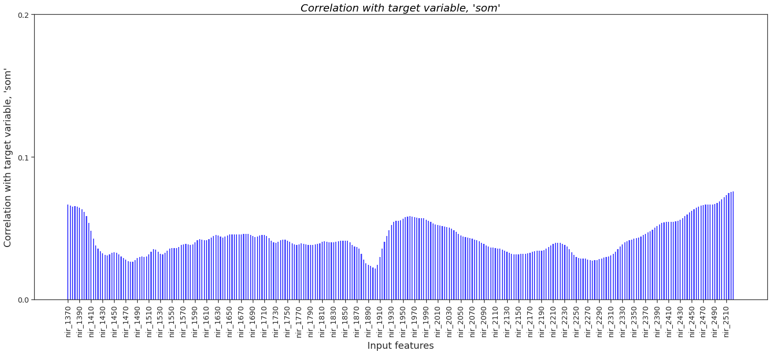
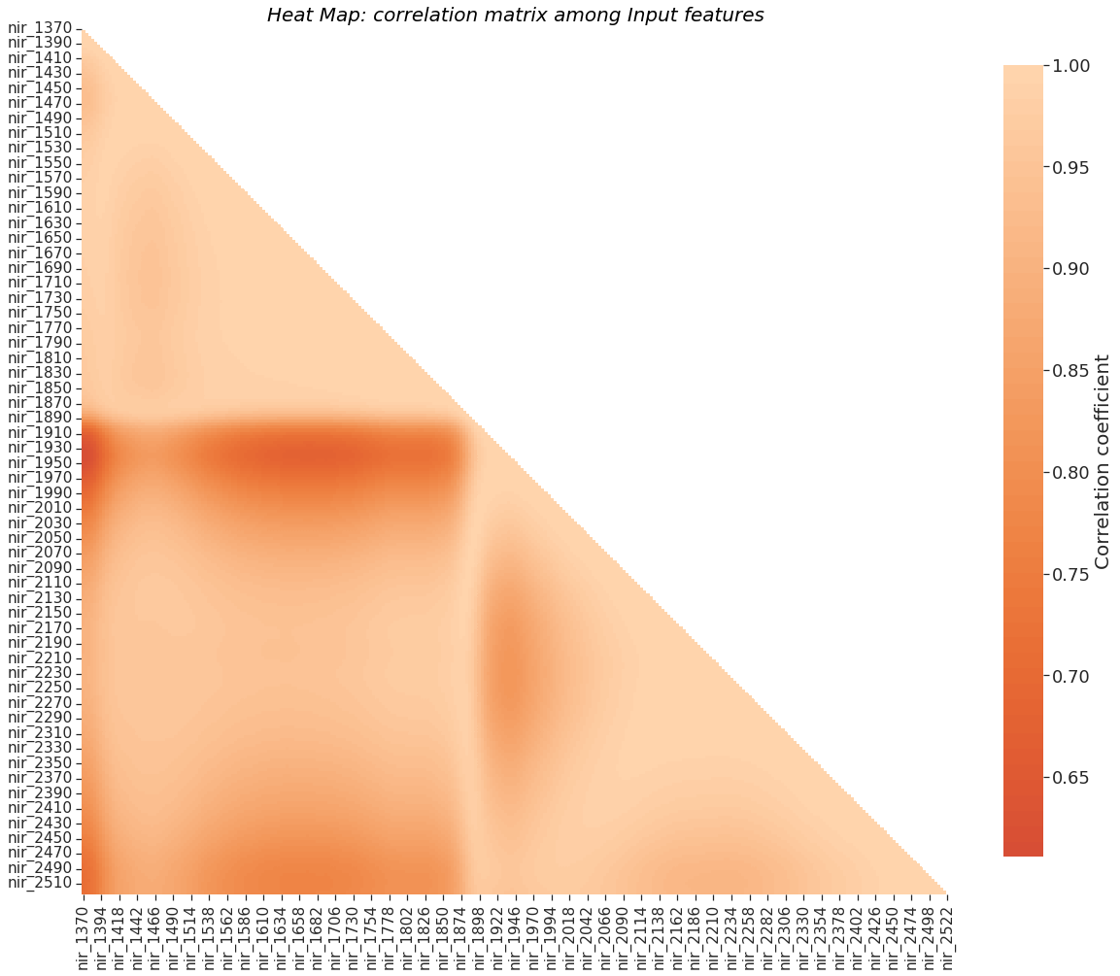
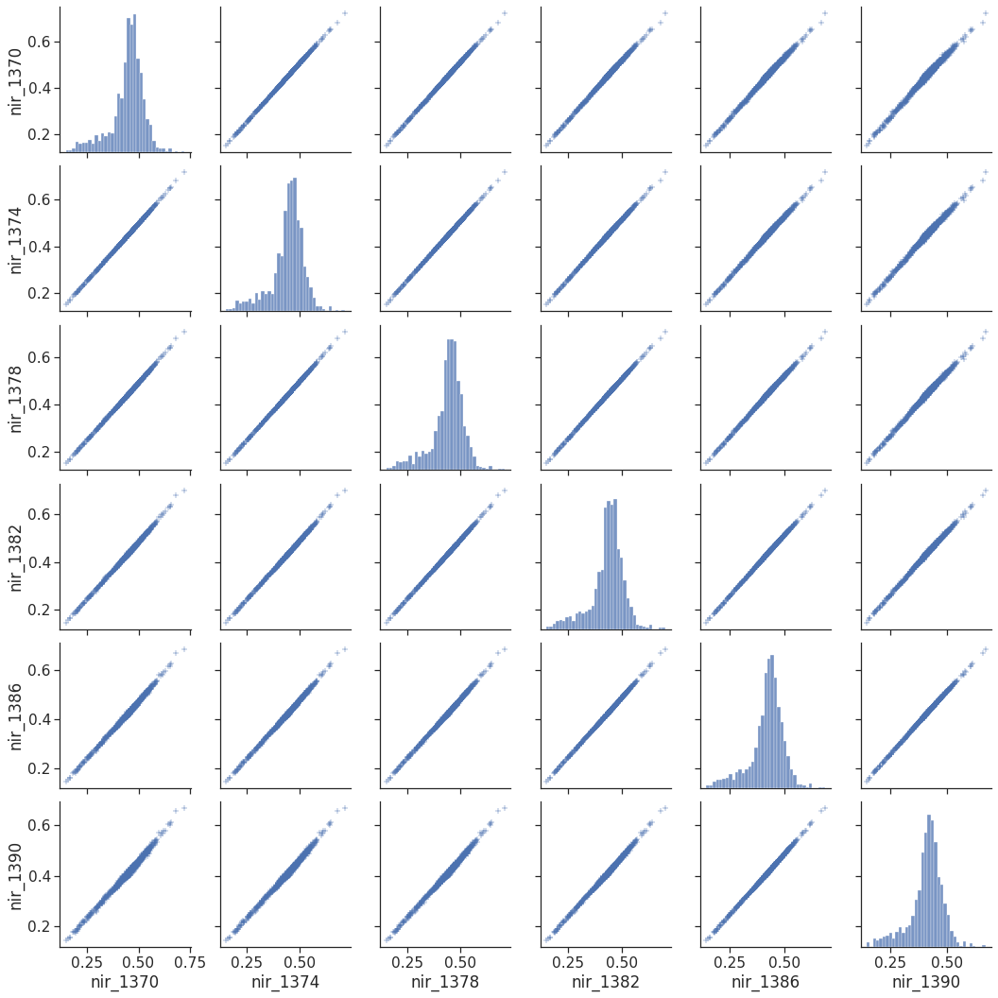
PART-3: Create models
Look into the correlation matrix among input features and between target variable and input features, it clearly shows that the training data has multicollinearity issues. After doing a research, the PLS (Partial Least Squares) and Ridge regression ALGT have found are the suitable one.
To evaluate the performance of the model, 3 datasets are used to train model (field_A, field_B, and all (field_A+field_B), and then use different data to predict.
Train | all | field_A | field_B
Pred | all/A/B | field_B | field_A
In order to evaluate two regression models, there are 4 main metrics are counted: Mean Absolute Error (MAE), Mean Squared Error (MSE), RMSE, mean absolute percentage error (MAPE)

Slide 22
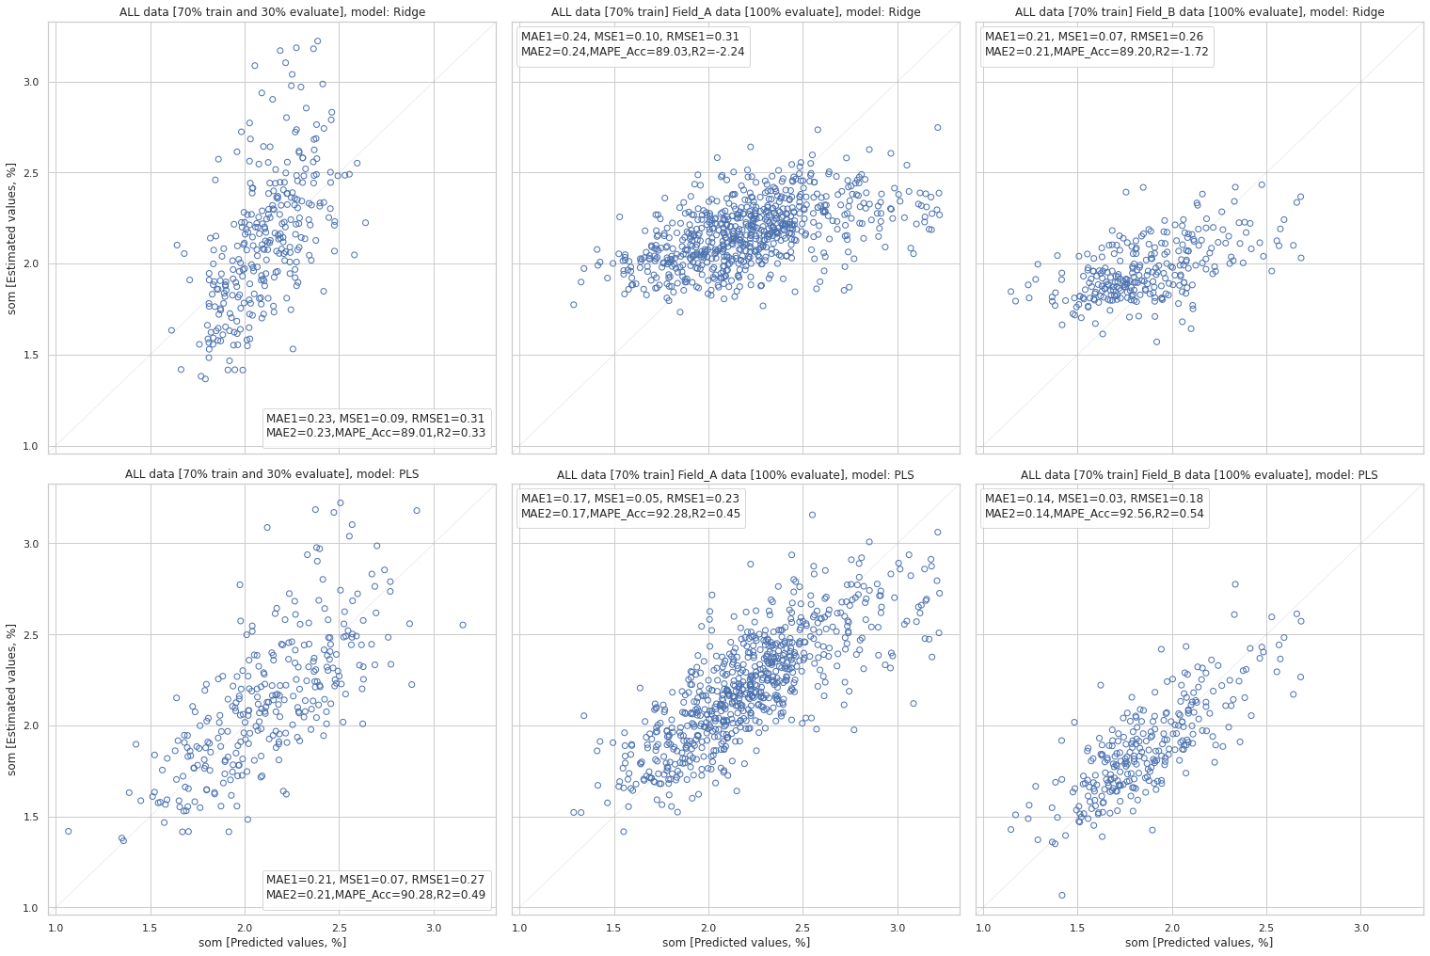
RIDGE & PLS regression ALGT results: ALL DATA (974 sample points)
To evaluate the performance of the models, the simplest way to split the modelling dataset into training and testing sets is to assign 2/3 data points to the former and the remaining one-third to the latter evaluation (the train-test procedure) . Therefore, we train the model using the training set and then apply the model to the test set.
Keep in mind that, the train-test procedure is not appropriate when the dataset available is small. The reason is that when the dataset is split into train and test sets, there will not be enough data in the training dataset for the model to learn an effective mapping of inputs to outputs. There will also not be enough data in the test set to effectively evaluate the model performance. The estimated performance could be overly optimistic (good) or overly pessimistic (bad).
Both models perform quite well in this case (All data, 974 sample points).

Slide 23
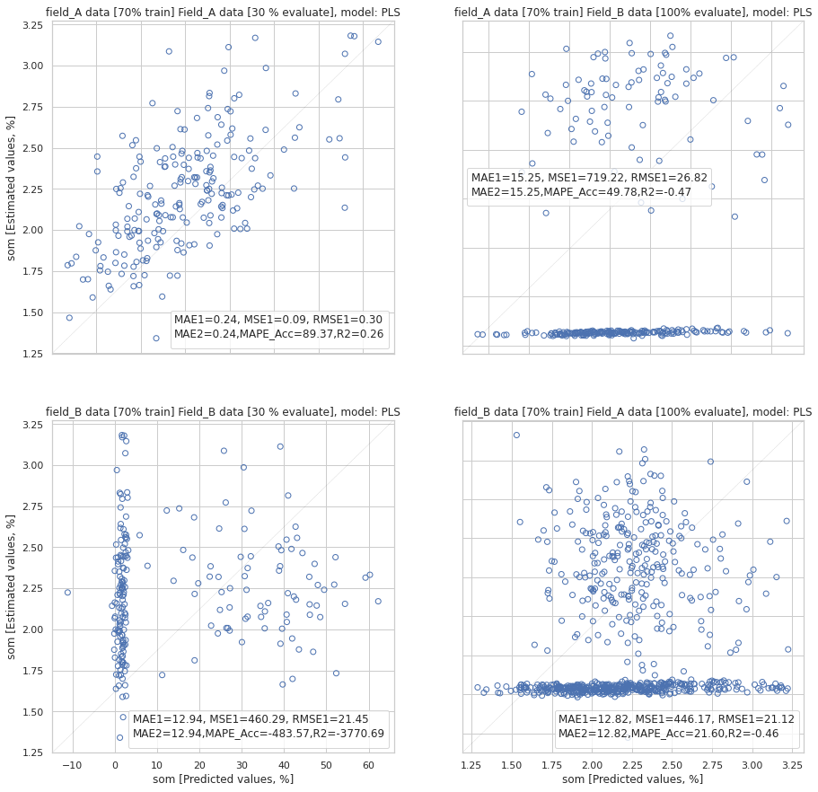
PLS regression ALGT results
PLS: field_A_based model 698 sample points
Both PLS ALGT models perform worst result in this case!
PLS: field_B_based model 276 sample points
The PLS regression ALGT does not perform well in this evaluation. A deeper look might required to understand the issues.

Slide 24
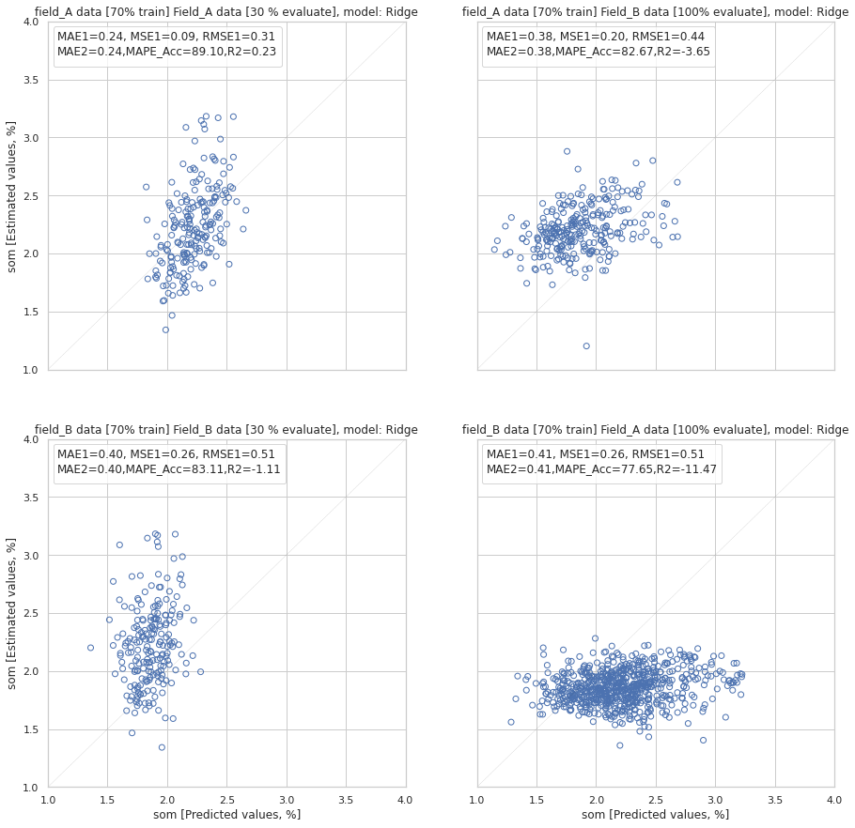
RIDGE regression ALGT results
RIDGE: field_A_based model 698 sample points
RIDGE ALGT field_A_based model perform quite well when apply to predict om for samples in field B!
RIDGE: field_B_based model 276 sample points
RIDGE ALGT field_B_based model perform worst well when apply to predict om for samples in field A!
The PLS regression ALGT does not perform well in this evaluation. A deeper look might required to understand the issues.

Slide 25
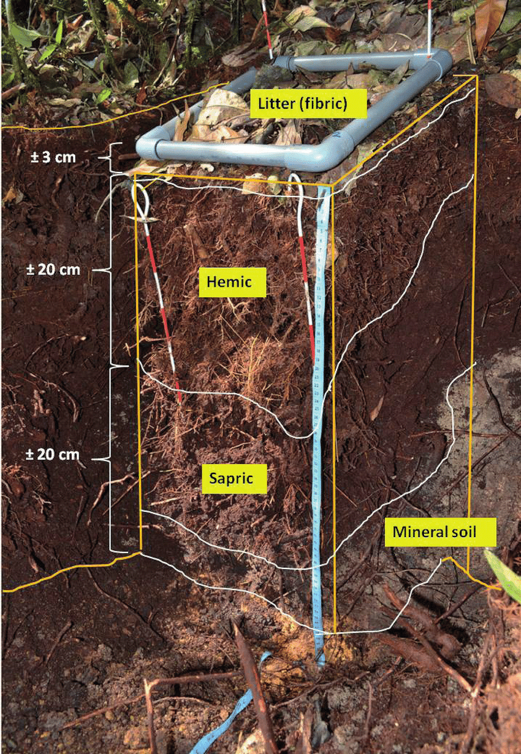
Next steps
For doing better job in identify/or develop the Model that be able to transfer between fields, regions, it is required to have a deep knowledge of soil parameters. Discussions with Soil scientists, Agronomist in the team would be a sufficient way of improving the knowledge and share opinions.
Read the book: Remote Sensing of Soils, and the article Reflectance Properties of Soils
Do more research/development works on dimensionality reduction
Study the soil indexes.
Work more on tuning Hyperparameters of the Model.
Find new features, which can be derived from the spectral reflection to be new input for the model.
source

Slide 26
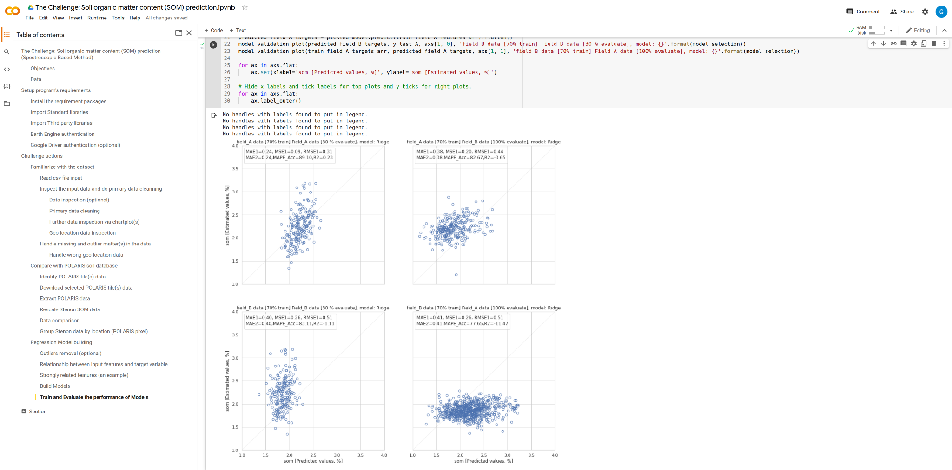
Appendix: The Code implementation in GoogleColab

